Slide 1




Database access using SQLite

Slide 2

Data
Quantities 1,2,3,…100,…1000…
Characters A, B, C…Z, a, b, c,…z
Symbols ! @ # $ % & * ()…
Quantities , Characters, Symbols are stored in digital format.
Data → plural Datum → singular
Data is Every Where
Machines, Robots, Sensors, Our self are products of data.
All roads lead to DATA.

Slide 3

Numerous kinds of data
Text data (.doc, .txt, .pdf…)
Excel data (.csv, .tsv)
HTML data
XML data
JSON data
Relational Database (Oracle, MySql, Sqlite…)
Log files / Transactional data
Sensors/Web servers
Social Media data (FB, Twitter, WhatsApp, YouTube…)
Image / Audio / Video / Signal….

Slide 4
Database
A Database is a shared collection of logically related data and description of these data, designed to meet the information needs of an organization
A Database Management System is a software system that enables users to define, create, maintain, and control access to the database.

Slide 5
Various Database systems
There are many different database systems which are used for a wide variety of purposes including: Oracle, MySQL, Microsoft SQL Server, PostgreSQL, and SQLite.
SQL is a programming language used by nearly all relational databases to
query,
manipulate, and
define data, and
to provide access control.

Slide 6
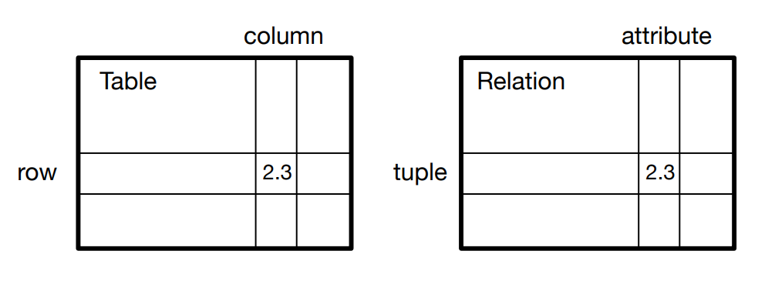
Relational Databases
Relational Databases store data in relations i.e., tables. Each relation must have a name.
The primary data structures in a database : tables, rows, and columns.
In technical descriptions of relational databases, the concepts of table, row, and column are formally referred to as relation, tuple, and attribute, respectively.

Slide 7
Working with Databases
A database is an abstraction over an operating system's file system that makes it easier for developers to build applications that create, read, update and delete persistent data.
At a high-level web applications store data and present it to users in a useful way.
Example
      Google stores data about roads and provides directions to get from one location to another by driving through the Maps application.
      Driving directions are possible because the data is stored in a structured format.
  Databases make structured storage reliable and fast.
Notes:
how to obtain data from more than one table.

Slide 8
Working with Databases
The database storage abstraction most used in Python web development is sets of relational tables.
      Relational databases store data in a series of tables.
      Interconnections between the tables are specified as foreign keys.
      A foreign key is a unique reference from one row in a relational table to another row in a table, which can be the same table but is most commonly a different table.
    Databases storage implementations vary in complexity.
    SQLite, a database included with Python, creates a single file for all data per database.
      Other databases such as PostgreSQL, MySQL, Oracle and Microsoft SQL Server have more complicated persistence schemes while offering additional advanced features that are useful for web application data storage.

Slide 9
SQLite database
SQLite is a software library that implements a self-contained, serverless, zero-configuration, transactional SQL database engine. SQLite is the most widely deployed SQL database engine in the world.
      SQLite does not require a separate server process or system to operate (serverless).
      SQLite comes with zero-configuration, which means no setup or administration needed.
      A complete SQLite database is stored in a single cross-platform disk file.
      SQLite is very small and light weight, less than 400KiB fully configured or less than 250KiB with optional features omitted.
      SQLite is self-contained, which means no external dependencies.
      SQLite transactions are fully ACID-compliant, allowing safe access from multiple processes or threads.
      Supports in all O.S, written in ANSI-C and provides simple and easy-to-use API.

Slide 10
ACID properties
Atomicity
      Atomic: a transaction should be atomic. It means that a change cannot be broken down into smaller ones.
      When you commit a transaction, either the entire transaction is applied or not.
Consistent:
      when the transaction is committed or rolled back, it is important that the transaction must keep the database consistent.
  Isolation
      In case if two transactions executing concurrently only respective transaction results will appear to the client, not other client's transaction results.
  Durability
      Durability means once the transaction committed successfully then it is guaranteed that all the changes committed permanently to the database

Slide 11
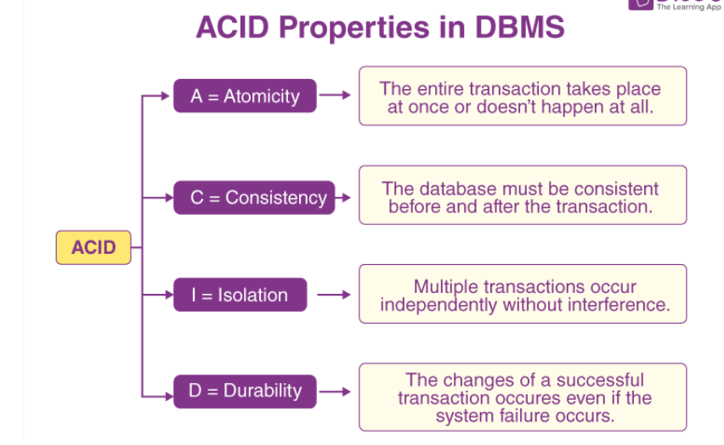
ACID properties

Slide 12
How to get start with databases
Databases require more defined structure than Python lists or dictionaries.
When we create a database table, we must tell the database in advance the names of each of the columns in the table and the type of data which we are planning to store in each column.
When the database software knows the type of data in each column, it can choose the most efficient way to store and look up the data based on the type of data.

Slide 13
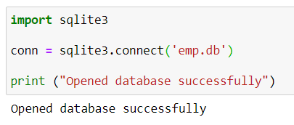
How to work with SQLite
      SQLite database is in-built in Python using sqlite3 module
      When we connect to an SQLite database file that does not exist, SQLite automatically creates the new database for us.
      To create a database, first, we must create a Connection object that represents the database using the connect() function of the sqlite3 module.
import sqlite3
conn = sqlite3.connect('emp.db')
print ("Opened database successfully")

Slide 14
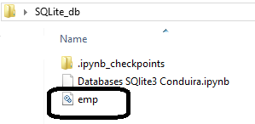
Steps to work with SQLite
The connect() function opens a connection to an SQLite database. It returns a Connection object that represents the database. By using the Connection object, you can perform various database operations.
import sqlite3
conn = sqlite3.connect('emp.db')
print ("Opened database successfully")

Slide 15
Steps to work with SQLite
Note:
If we skip the folder path C:\Users\PERSONAL\Desktop\SQLite_db, the program will create the database file in the current working directory (CWD).
If we pass the file name as :memory: to the connect() function of the sqlite3 module, it will create a new database that resides in the memory (RAM) instead of a database file on disk.
import sqlite3
conn = sqlite3.connect(':memory:')
print ("Opened database successfully")

Slide 16
Creating Tables in SQLite
To create a new table in an SQLite database from a Python program, you use the following steps:
      First, create a Connection object using the connect() method of the sqlite3 module.
      Second, create a Cursor object by calling the cursor() method of the Connection object.
      Third, pass the CREATE TABLE statement to the execute() method of the Cursor object and execute this method.

Slide 17
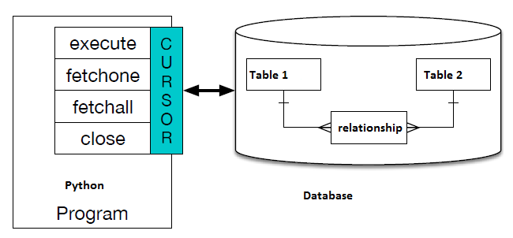
Database cursors
A cursor is like a file handle that we can use to perform operations on the data stored in the database.
Calling cursor() is very similar conceptually to calling open() when dealing with text files.
Once we have the cursor, we can begin to execute commands on the contents of the database using the execute() method.

Slide 18
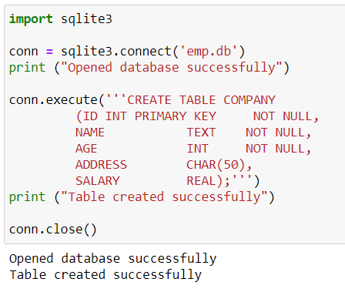
Creating Tables in SQLite
import sqlite3
conn = sqlite3.connect('emp.db')
print ("Opened database successfully")
conn.execute('''CREATE TABLE COMPANY
(ID INT PRIMARY KEY NOT NULL,
NAME TEXT NOT NULL,
AGE INT NOT NULL,
ADDRESS CHAR(50),
SALARY REAL);''')
print ("Table created successfully")
conn.close()

Slide 19
CURD operations using SQLite

Slide 20
CURD operations using SQLite
CURD stands for CREATE, UPDATE, RETRIEVE, DELETE operations.
      Create – Insert operation
      Update- Update operation
      Retrieve – Select operation
      Delete – Delete operation
Notes:
how to obtain data from more than one table.

Slide 21
Insert data into SQLite
import sqlite3
conn = sqlite3.connect('emp.db')
print ("Opened database successfully")
conn.execute("INSERT INTO COMPANY (ID,NAME,AGE,ADDRESS,SALARY)VALUES (1, 'Paul', 32, 'California', 20000.00 )");
conn.execute("INSERT INTO COMPANY (ID,NAME,AGE,ADDRESS,SALARY) VALUES (2, 'Allen', 25, 'Texas', 15000.00 )");
conn.execute("INSERT INTO COMPANY (ID,NAME,AGE,ADDRESS,SALARY) VALUES (3, 'Teddy', 23, 'Norway', 20000.00 )");
conn.execute("INSERT INTO COMPANY (ID,NAME,AGE,ADDRESS,SALARY) VALUES (4, 'Mark', 25, 'Rich-Mond ', 65000.00 )");
conn.commit()
print ("Records created successfully")
conn.close()
Opened database successfully
Records created successfully

Slide 22
Select data from SQLite
import sqlite3
conn = sqlite3.connect('emp.db')
print ("Opened database successfully")
cursor = conn.execute("SELECT id, name, address, salary from COMPANY")
for row in cursor:
print ("ID = ", row[0])
print ("NAME = ", row[1])
print ("ADDRESS = ", row[2])
print ("SALARY = ", row[3], "\n")
print ("Operation done successfully")
conn.close()
Opened database successfully
ID = 1
NAME = Paul
ADDRESS = California
SALARY = 25000.0
ID = 2
NAME = Allen
ADDRESS = Texas
SALARY = 15000.0
..
..
ID = 4
NAME = Mark
ADDRESS = Rich-Mond
SALARY = 65000.0
Operation done successfully

Slide 23
Cursor methods
cursor.fetchall() fetches all the rows of a query result.
      It returns all the rows as a list of tuples.
      An empty list is returned if there is no record to fetch.
cursor.fetchmany(size) returns the number of rows specified by size argument.
      When called repeatedly this method fetches the next set of rows of a query result and returns a list of tuples.
      If no more rows are available, it returns an empty list.
cursor.fetchone() method returns a single record or None if no more rows are available.

Slide 24
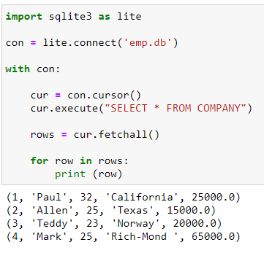
Select data from SQLite
import sqlite3 as lite
con = lite.connect('emp.db')
with con:
cur = con.cursor()
cur.execute("SELECT * FROM COMPANY")
rows = cur.fetchall()
for row in rows:
print (row)

Slide 25
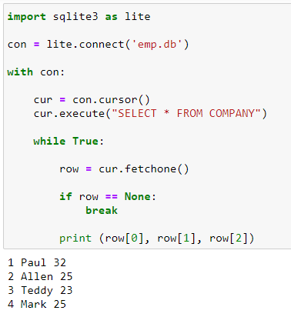
Retrieving one record at a time
import sqlite3 as lite
con = lite.connect('emp.db')
with con:
cur = con.cursor()
cur.execute("SELECT * FROM COMPANY")
while True:
row = cur.fetchone()
if row == None:
break
print (row[0], row[1], row[2])

Slide 26
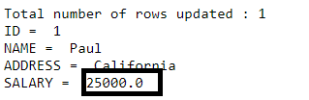
Update SQLite data
import sqlite3
conn = sqlite3.connect('emp.db')
conn.execute("UPDATE COMPANY set SALARY = 25000.00 where ID = 1")
conn.commit()
print ("Total number of rows updated :", conn.total_changes)
cursor = conn.execute("SELECT id, name, address, salary from COMPANY")
for row in cursor:
print ("ID = ", row[0])
print ("NAME = ", row[1])
print ("ADDRESS = ", row[2])
print ("SALARY = ", row[3], "\n")
conn.close()

Slide 27
Deleting data from SQLite
import sqlite3
conn = sqlite3.connect('emp.db')
print ("Opened database successfully")
conn.execute("DELETE from COMPANY where ID = 2;")
conn.commit()
print ("Total number of rows deleted :", conn.total_changes)
cursor = conn.execute("SELECT id, name, address, salary from COMPANY")
for row in cursor:
print ("ID = ", row[0])
print ("NAME = ", row[1])
print ("ADDRESS = ", row[2])
print ("SALARY = ", row[3], "\n")
print ("Operation done successfully")
conn.close()
Opened database successfully
Total number of rows deleted : 1
ID = 1
NAME = Paul
ADDRESS = California
SALARY = 25000.0
ID = 3
NAME = Teddy
ADDRESS = Norway
SALARY = 20000.0
ID = 4
NAME = Mark
ADDRESS = Rich-Mond
SALARY = 65000.0
Operation done successfully

Slide 28
Database access using SQLite
Part 2
Dr Venkat Raju

Slide 29
Parameterized queries
A parameterized query is a query in which placeholders used for parameters and the parameter values supplied at execution time.
That means parameterized query gets compiled only once.
There are the main 4 reasons to use
      Improves Speed: If you want to execute SQL statement/query many times, it usually reduces execution time
      Compile Once: The main advantage of using a parameterized query is that parameterized query compiled only once
      Same Operation with Different Data: if you want to execute the same query multiple times with different data.
      Preventing SQL injection attacks.

Slide 30
Parameterized queries
import sqlite3
conn = sqlite3.connect('LanguageDB')
cur = conn.cursor()
cur.execute('DROP TABLE IF EXISTS languages')
cur.execute('CREATE TABLE languages (subject TEXT, marks INTEGER)')
cur.execute('INSERT INTO languages (subject, marks) VALUES (?, ?)', ('C', 100))
cur.execute('INSERT INTO languages (subject, marks) VALUES (?, ?)', ('Java', 200))
cur.execute('INSERT INTO languages (subject, marks) VALUES (?, ?)', ('Python', 300))
conn.commit()
print('Languages:')
cur.execute('SELECT subject, marks FROM languages')
for row in cur:
print(row)
cur.close()
Languages:
('C', 100)
('Java', 200)
('Python', 300)

Slide 31
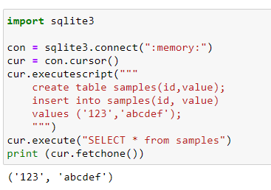
executescript() - executing multiple SQL statements
This is a nonstandard convenience method for executing multiple SQL statements at once. It issues a COMMIT statement first, then executes the SQL script it gets as a parameter.
import sqlite3
con = sqlite3.connect(":memory:")
cur = con.cursor()
cur.executescript("""
create table samples(id,value);
insert into samples(id, value) values ('123','abcdef');
""")
cur.execute("SELECT * from samples")
print (cur.fetchone())

Slide 32
Consider database as emp.db
emp10.db
(1, 'Paul', 32, 'California', 20000.0)
(2, 'Allen', 25, 'Texas', 15000.0)
(3, 'Teddy', 23, 'Norway', 20000.0)
(4, 'Mark', 25, 'Rich-Mond ', 65000.0)
Notes:
how to obtain data from more than one table.

Slide 33
select with where clause
import sqlite3 as lite
con = lite.connect('emp10.db')
with con:
cur = con.cursor()
cur.execute("SELECT * FROM COMPANY where ID=1")
rows = cur.fetchall()
for row in rows:
print (row)
(1, 'Paul', 32, 'California', 20000.0)

Slide 34
select with where clause
import sqlite3 as lite
con = lite.connect('emp0.db')
with con:
cur = con.cursor()
cur.execute("SELECT * FROM COMPANY where NAME='Paul'")
rows = cur.fetchall()
for row in rows:
print (row)
(1, 'Paul', 32, 'California', 25000.0)

Slide 35
select with where clause
import sqlite3 as lite
con = lite.connect('emp10.db')
with con:
cur = con.cursor()
cur.execute("SELECT * FROM COMPANY where SALARY >=30000")
rows = cur.fetchall()
for row in rows:
print (row)
(4, 'Mark', 25, 'Rich-Mond ', 65000.0)

Slide 36
select with order by clause
import sqlite3 as lite
con = lite.connect('emp10.db')
with con:
cur = con.cursor()
cur.execute("SELECT * FROM COMPANY ORDER BY SALARY")
rows = cur.fetchall()
for row in rows:
print (row)
(2, 'Allen', 25, 'Texas', 15000.0)
(1, 'Paul', 32, 'California', 20000.0)
(3, 'Teddy', 23, 'Norway', 20000.0)
(4, 'Mark', 25, 'Rich-Mond ', 65000.0)

Slide 37
select with where clause (like operator)
import sqlite3 as lite
con = lite.connect('emp10.db')
with con:
cur = con.cursor()
cur.execute("SELECT * FROM COMPANY WHERE NAME LIKE 'a%'")
rows = cur.fetchall()
for row in rows:
print (row)
(2, 'Allen', 25, 'Texas', 15000.0)

Slide 38
select with where clause (max())
import sqlite3 as lite
con = lite.connect('emp10.db')
with con:
cur = con.cursor()
cur.execute("SELECT MAX(salary) FROM COMPANY")
rows = cur.fetchall()
for row in rows:
print (row)
(65000.0,)

Slide 39
Working with JOINS

Slide 40
Working with Joins using SQLite
SQLite JOINS are used to retrieve data from multiple tables.
An SQLite JOIN is performed whenever two or more tables are joined in a SQL statement.
There are different types of SQLite joins:
      INNER JOIN (or sometimes called simple join)
      LEFT OUTER JOIN (or sometimes called LEFT JOIN)
      CROSS JOIN
  Note : SQLite doesn’t directly support the RIGHT JOIN and FULL OUTER JOIN.
Notes:
how to obtain data from more than one table.

Slide 41
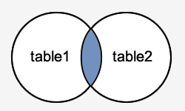
Inner Join
SQLite INNER JOINS return all rows from multiple tables where the join condition is met.
The syntax for the INNER JOIN in SQLite is:
SELECT columns
FROM table1
INNER JOIN table2
ON table1.column = table2.column;
In this visual diagram, the SQLite INNER JOIN returns the shaded area:
SELECT employees.employee_id, employees.last_name, positions.title
FROM employees
INNER JOIN positions
ON employees.position_id = positions.position_id;
return all rows from the employees and positions tables where there is a matching position_id value in both the employees and positions tables.

Slide 42
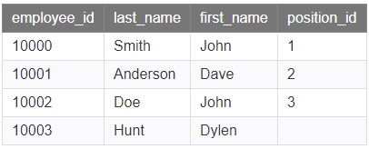
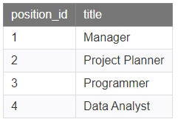
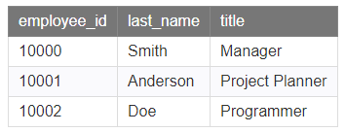
Inner Join
employees
positions
Result table
The row for employee_id 10003 from the employees table would be omitted, since the corresponding position_id does not exist in the positions table.
The row for the position_id of 4 from the positions table would be omitted, since that position_id does not exist in the employees table.

Slide 43
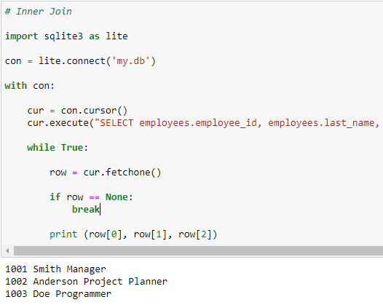
Implementation of inner join
# Inner Join
import sqlite3 as lite
con = lite.connect('my.db')
with con:
cur = con.cursor()
cur.execute("SELECT employees.employee_id, employees.last_name,
positions.title FROM employees INNER JOIN positions ON
employees.position_id = positions.position_id;")
while True:
row = cur.fetchone()
if row == None:
break
print (row[0], row[1], row[2])

Slide 44
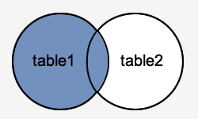
LEFT OUTER JOIN
Outer join returns all rows from the LEFT-hand table specified in the ON condition and only those rows from the other table where the joined fields are equal (join condition is met).
The syntax for the SQLite LEFT OUTER JOIN is:
SELECT columns
FROM table1
LEFT [OUTER] JOIN table2
ON table1.column = table2.column;
SELECT employees.employee_id, employees.last_name, positions.title
FROM employees
LEFT OUTER JOIN positions
ON employees.position_id = positions.position_id;
The SQLite LEFT OUTER JOIN would return the all records from table1 and only those records from table2 that intersect with table1.

Slide 45
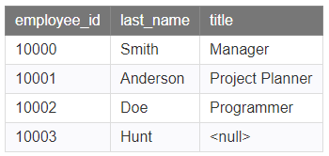
LEFT OUTER JOIN
employees
positions
Result table
The row for employee_id 10003 would be included because a LEFT OUTER JOIN was used.
However, you will notice that the title field for that record contains a <null> value since there is no corresponding row in the positions table.

Slide 46
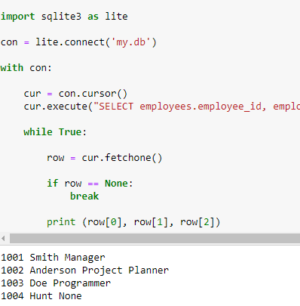
Implementation of LEFT OUTER JOIN
import sqlite3 as lite
con = lite.connect('my.db')
with con:
cur = con.cursor()
cur.execute("SELECT employees.employee_id, employees.last_name, positions.title
FROM employees LEFT OUTER JOIN positions ON employees.position_id = positions.position_id;")
while True:
row = cur.fetchone()
if row == None:
break
print (row[0], row[1], row[2])

Slide 47
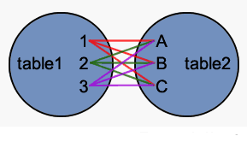
CROSS JOIN
This type of join returns a combined result set with every row from the first table matched with every row from the second table. This is also called a Cartesian Product.
The syntax for the SQLite CROSS JOIN is:
SELECT columns
FROM table1
CROSS JOIN table2;

Slide 48
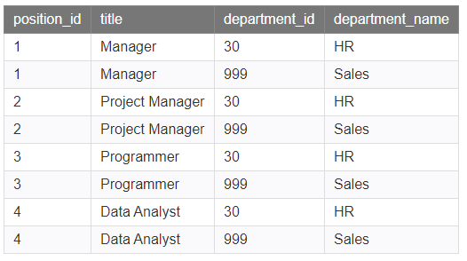
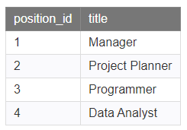
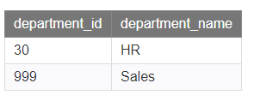
CROSS JOIN
Since the positions table has 4 rows and the departments has 2 rows, the cross join will return 8 rows (because 4x2=8).
Each row from the positions table is matched with each row from the departments table.

Slide 49
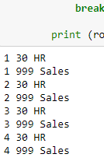
Implementation of CROSS JOIN
import sqlite3 as lite
con = lite.connect('my.db')
with con:
cur = con.cursor()
cur.execute("SELECT position_id, department_id,
department_name FROM positions CROSS JOIN departments;")
while True:
row = cur.fetchone()
if row == None:
break
print (row[0], row[1], row[2])

Slide 50
Transactions using SQLite

Slide 51
Transactions
SQLite is a transactional database that all changes and queries are atomic, consistent, isolated, and durable (ACID).
SQLite guarantees all the transactions are ACID compliant even if the transaction is interrupted by a program crash, operation system dump, or power failure to the computer.
The following commands are used to control transactions.
        COMMIT − to save the changes.
        ROLLBACK − to roll back the changes.

Slide 52
ACID properties
Atomicity
      Atomic: a transaction should be atomic. It means that a change cannot be broken down into smaller ones.
      When you commit a transaction, either the entire transaction is applied or not.
Consistent:
      when the transaction is committed or rolled back, it is important that the transaction must keep the database consistent.
  Isolation
      In case if two transactions executing concurrently only respective transaction results will appear to the client, not other client's transaction results.
  Durability
      Durability means once the transaction committed successfully then it is guaranteed that all the changes committed permanently to the database

Slide 53
Creating a Transaction and rollback()
import sqlite3 as lite
import sys
con = lite.connect('test.db')
#con = lite.connect('test.db', isolation_level=None)
cur = con.cursor()
cur.execute("CREATE TABLE temp(id INTEGER PRIMARY KEY, name TEXT)")
cur.execute("INSERT INTO temp(name) VALUES ('Tom')")
cur.execute("INSERT INTO temp(name) VALUES ('Rebecca')")
cur.execute("INSERT INTO temp(name) VALUES ('Jim')")
cur.execute("INSERT INTO temp(name) VALUES ('Robert')")
#con.commit()
con.rollback()
con.close()
import sqlite3 as lite
con = lite.connect('test.db')
with con:
cur = con.cursor()
cur.execute("SELECT * FROM temp")
while True:
row = cur.fetchone()
if row == None:
break
print (row[0], row[1])

